Slide 1
Video Shot Detection
CIS 581 Course Project
Heshan Lin

Slide 2
Agenda
What’s shot detection?
Classification of shot detection
Close look to hard cuts detection
Experiments and Results

Slide 3
What’s Shot Detection
Problem definition
– shot detection: given a video V consisting of n shots, find the beginning and end of each shot.
Also known as shot boundary detection or transition detection.
It is fundamental to any kind of video analysis and video application since it enables segmentation of a video into its basic components: the shots.

Slide 4
Classification
Hard cuts: A cut is an instantaneous transition from one scene to the next. There are no transitional frames between 2 shots.
Fades: A fade is a gradual transition between a scene and a constant image (fade-out) or between a constant image and a scene (fade-in).
Notes:
Classified based on transition types

Slide 5
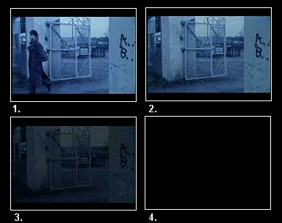
Fades
During a fade, images have their intensities multiplied by some value α. During a fade-in, α increases from 0 to 1, while during a fade-out α decreases from 1 to 0.
Notes:
Qiang’s movie

Slide 6
Classification
Hard cuts: A cut is an instantaneous transition from one scene to the next.
Fades: A fade is a gradual transition between a scene and a constant image (fade-out) or between a constant image and a scene (fade-in).
Dissolves: A dissolve is a gradual transition from one scene to another, in which the first scene fades out and the second scene fades in.
Notes:
Classified based on transition types

Slide 7

Dissolves
Combination of fade-in and fade-out.

Slide 8
Classification
Hard cuts: A cut is an instantaneous transition from one scene to the next.
Fades: A fade is a gradual transition between a scene and a constant image (fade-out) or between a constant image and a scene (fade-in).
Dissolves: A dissolve is a gradual transition from one scene to another, in which the first scene fades out and the second scene fades in.
Wipe: another common scene break is a wipe, in which a line moves across the screen, with the new scene appearing behind the line.
Notes:
Germy’s movie

Slide 9
Schema of Cut Detection
Calculate a time series of discontinuity feature values f(n) for each frame. Suppose we use function d(x,y) to measure the dissimilarity between frame x and y. The discontinuity feature value for frame n is f(n)=d(n-1,n).
Pick the cuts position from f(n) based on some threshold techniques.
Notes:
My project only cover cuts detection

Slide 10
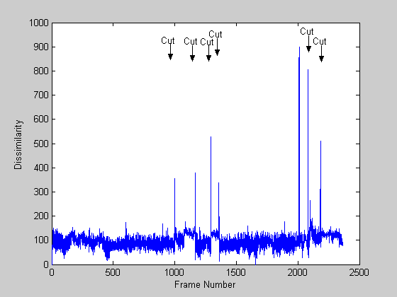
Example

Slide 11
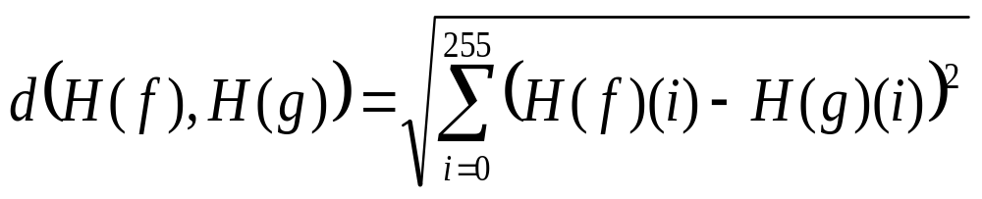
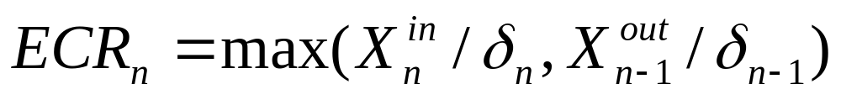
Features to Measure Dissimilarity
Intensity/color histogram
Edges/contours: Based on edge change ratio (ECR). Let σ_{n} be the number of edge pixels in frame n, and X_{n}^{in} and X_{n-1}^{out} the number of entering and exiting edge pixels in frames in frames n and n-1, respectively. The edge change ratio ECR_{n} between frames n-1 and n is defined as:
Notes:
Our approach is based on a simple observation: during a cut or a dissolve, new intensity edges appear far from the
locations of old edges. Similarly, old edges disappear far from the location of new edges. We define an edge pixel that appears far from an existing edge pixel as an entering edge pixel, and an edge pixel that disappears far from an existing edge pixel as an exiting edge pixel. By counting the entering and exiting edge pixels, we can detect and classify cuts, fades and dissolves. By analyzing the spatial distribution of entering and exiting edge pixels, we can detect and classify wipes.

Slide 12
Edges/contours (cont.)
How to define the entering and exiting edge pixels X_{n}^{in} and X_{n-1}^{out}?
Suppose we have 2 binary images e_{n-1} and e_{n}. The entering edge pixels X_{n}^{in} are the fraction of edge pixels in e_{n} which are more than a fixed distance r from the closest edge pixel in e_{n-1}. Similarly the exiting edge pixels are the fraction of edge pixels in e_{n-1} which are farther than r away from the closest edge pixel in e_{n}.
Not entering edge
E_{n-1}
E_{n}
Entering edge
Impose E_{n} to E_{n-1}

Slide 13
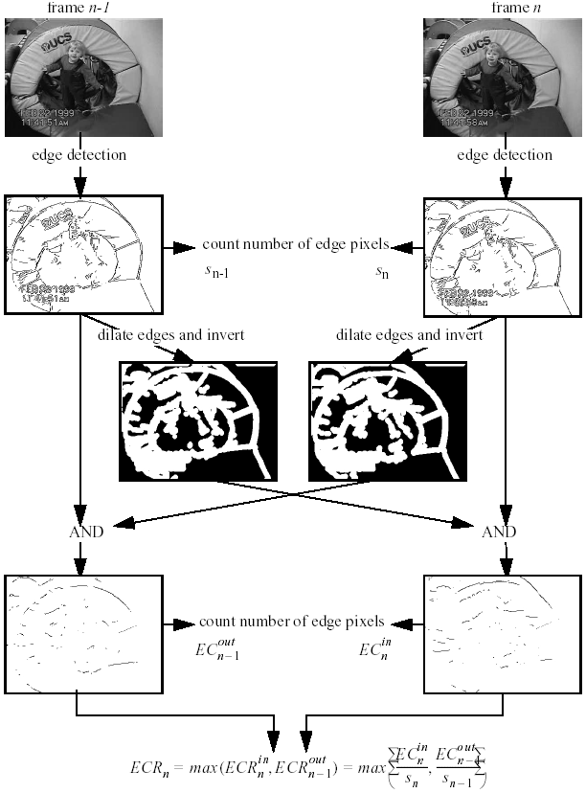
We can set the distance r by specify the Dilate parameter
imd1 = rgb2gray(im1);
Imd2 = rgb2gray(im2);
% black background image
bw1 = edge(imd1, 'sobel');
bw2 = edge(imd2, 'sobel');
% invert image to white background
ibw2 = 1-bw2;
ibw1 = 1-bw1;
s1 = size(find(bw1),1);
s2 = size(find(bw1),1);
% dilate
se = strel('square',3);
dbw1 = imdilate(bw1, se);
dbw2 = imdilate(bw2, se);
imIn = dbw1 & ibw2;
imOut = dbw2 & ibw1;
ECRIn = size(find(imIn),1)/s2;
ECROut = size(find(imOut),1)/s1;
ECR = max(ECRIn, ECROut);

Slide 14
Thresholding
Global threshold
A hard cut is declared each time the discontinuity value f(n) surpasses a global thresholds.
Adaptive threshold
A hard cut is detected based on the difference of the current feature values f(n) from its local neighborhood. Generally this kind of method has 2 criteria for a hard cut declaration:
- F(n) takes the maximum value inside the neighborhood.
- The difference between f(n) and its neighbors’ feature values is bigger than a given threshold.
Notes:
A common problem of global thresholding is that in practice it is impossible to find a single global threshold that works with all kinds of video material. Should be avoided.
Use slide window, an example of adaptive threshold.

Slide 15
Experiments
Input: Mr. Beans movie. (80*112, 2363 frames)
Dissimilarity function
- Intensity histogram
- Edge change ratio (ECR)
Thresholding
- Adaptive threshold based on statistics model.

Slide 16
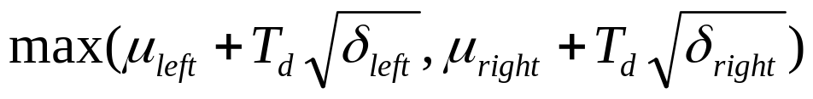
Thresholding
Use a slide window with size 2w+1.
The middle frame in the window is detected as a cut if:
- Its feature value is the maximum in the window.
- Its feature value is greater than
where T_{d} is a parameter given a value of 5 in this experiment.
Notes:
Draw some graph to explain windows size here.

Slide 17
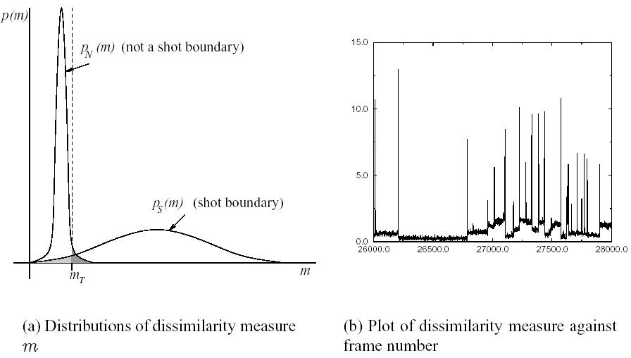
The statistics model is based on following assumption:
The dissimilarity feature values f(n) for a frame comes from two distributions: one for shot boundaries(S) and one for “not-a-shot-boundary”(N). In general, S has a considerably larger mean and standard deviation than N.
Threshold

Slide 18
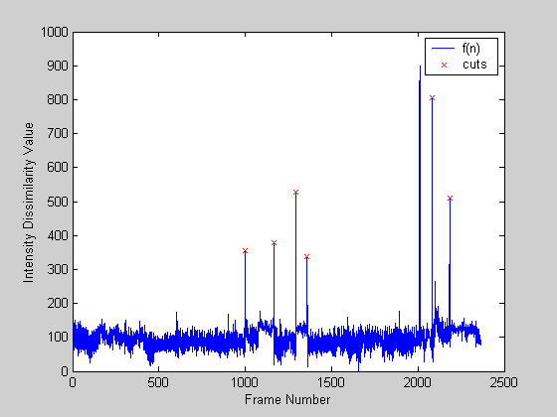
Results
Intensity histogram dissimilarity + adaptive thresholding

Slide 19
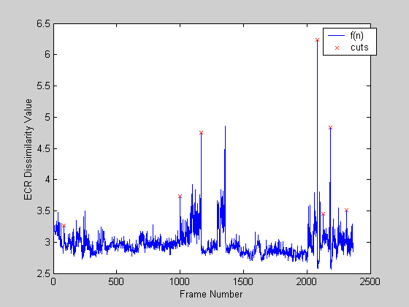
Results(cont.)
ECR dissimilarity + adaptive thresholding

Slide 20
Compare
We compare the cut positions detected by these 2 methods in the following table. From the results we can see the cut detected by these 2 methods are pretty stable.
Frame# | Cut1 | Cut2 | Cut3 | Cut4 | Cut5 | Cut6 | Cut7
Intensity Histogram | 998 | 1167 | 1292 | 1359 | 2081 | 2184
ECR | 86 | 998 | 1167 | 2081 | 2129 | 2184 | 2312

Slide 21
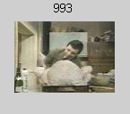

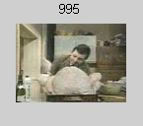
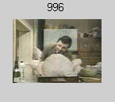
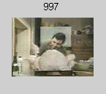
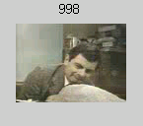



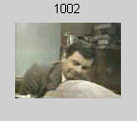
Cut detected in frame 998

Slide 22
Comments

